Slide 1
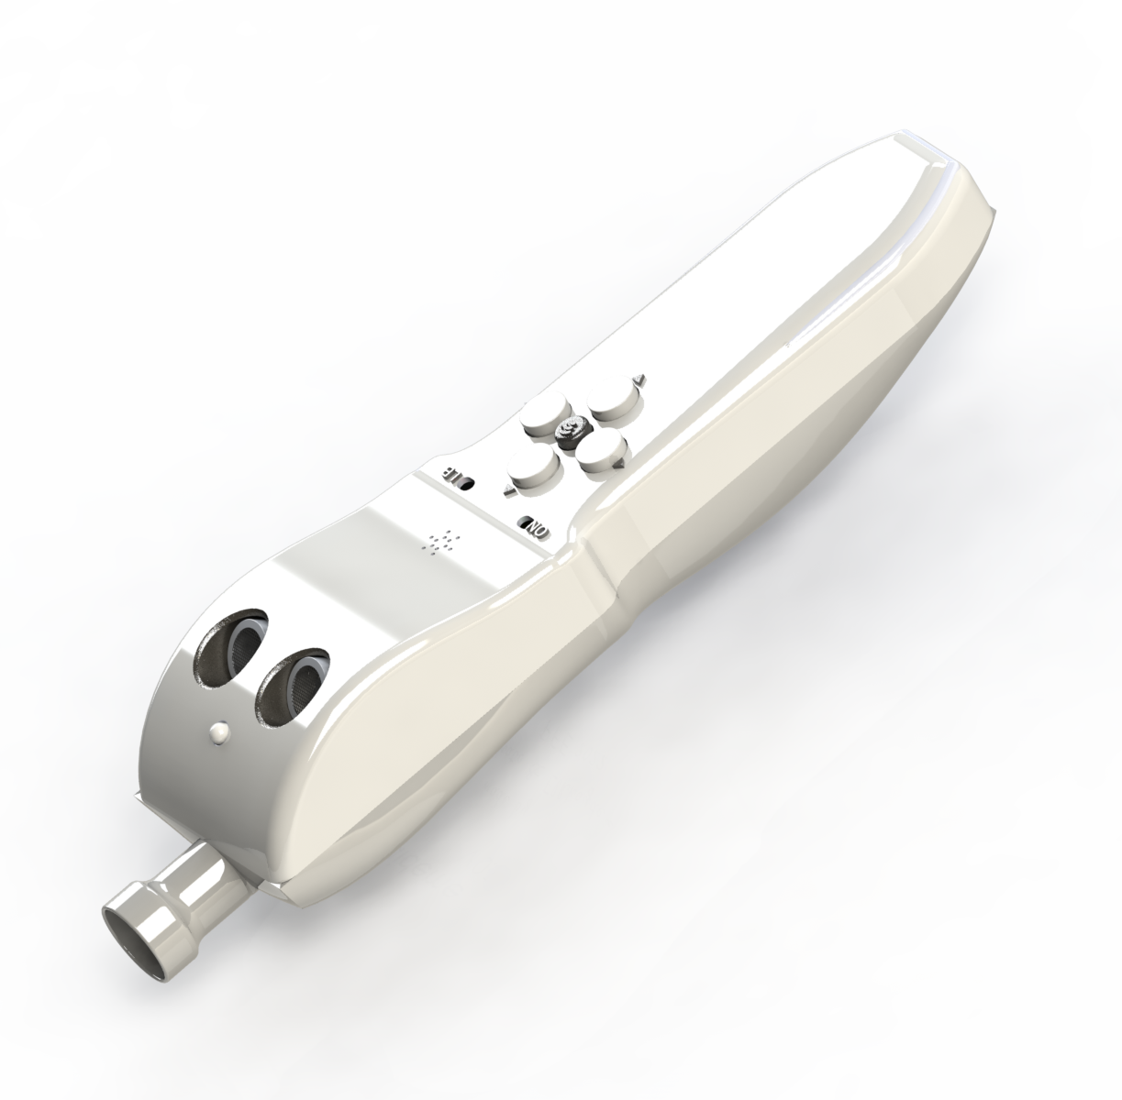

GuideMe Your navigation companion
Presented by:
- EL KHAYDER Zakaria
- OUCHATO Iliass
Supervised by:
- Pr. DKHICHI Fayrouz

Slide 2
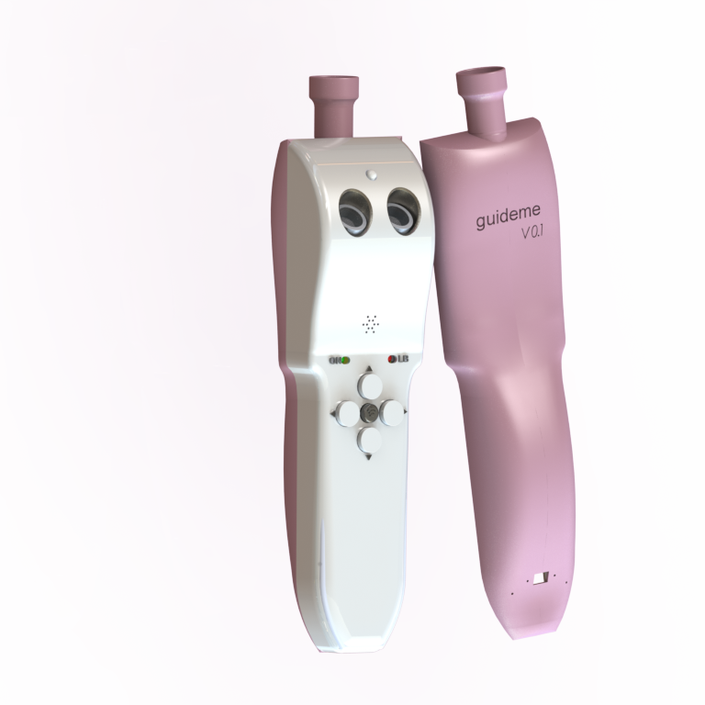
TABLE OF CONTENTS
01
02
03
INTRODUCTION
Summary, problematic & solutions
Design
Ergonomics, usability & Visual appeal
Features and functionalities
Architecture, features & usage

Slide 3
01
INTRODUCTION
Problematic, difficulties & solutions

Slide 4
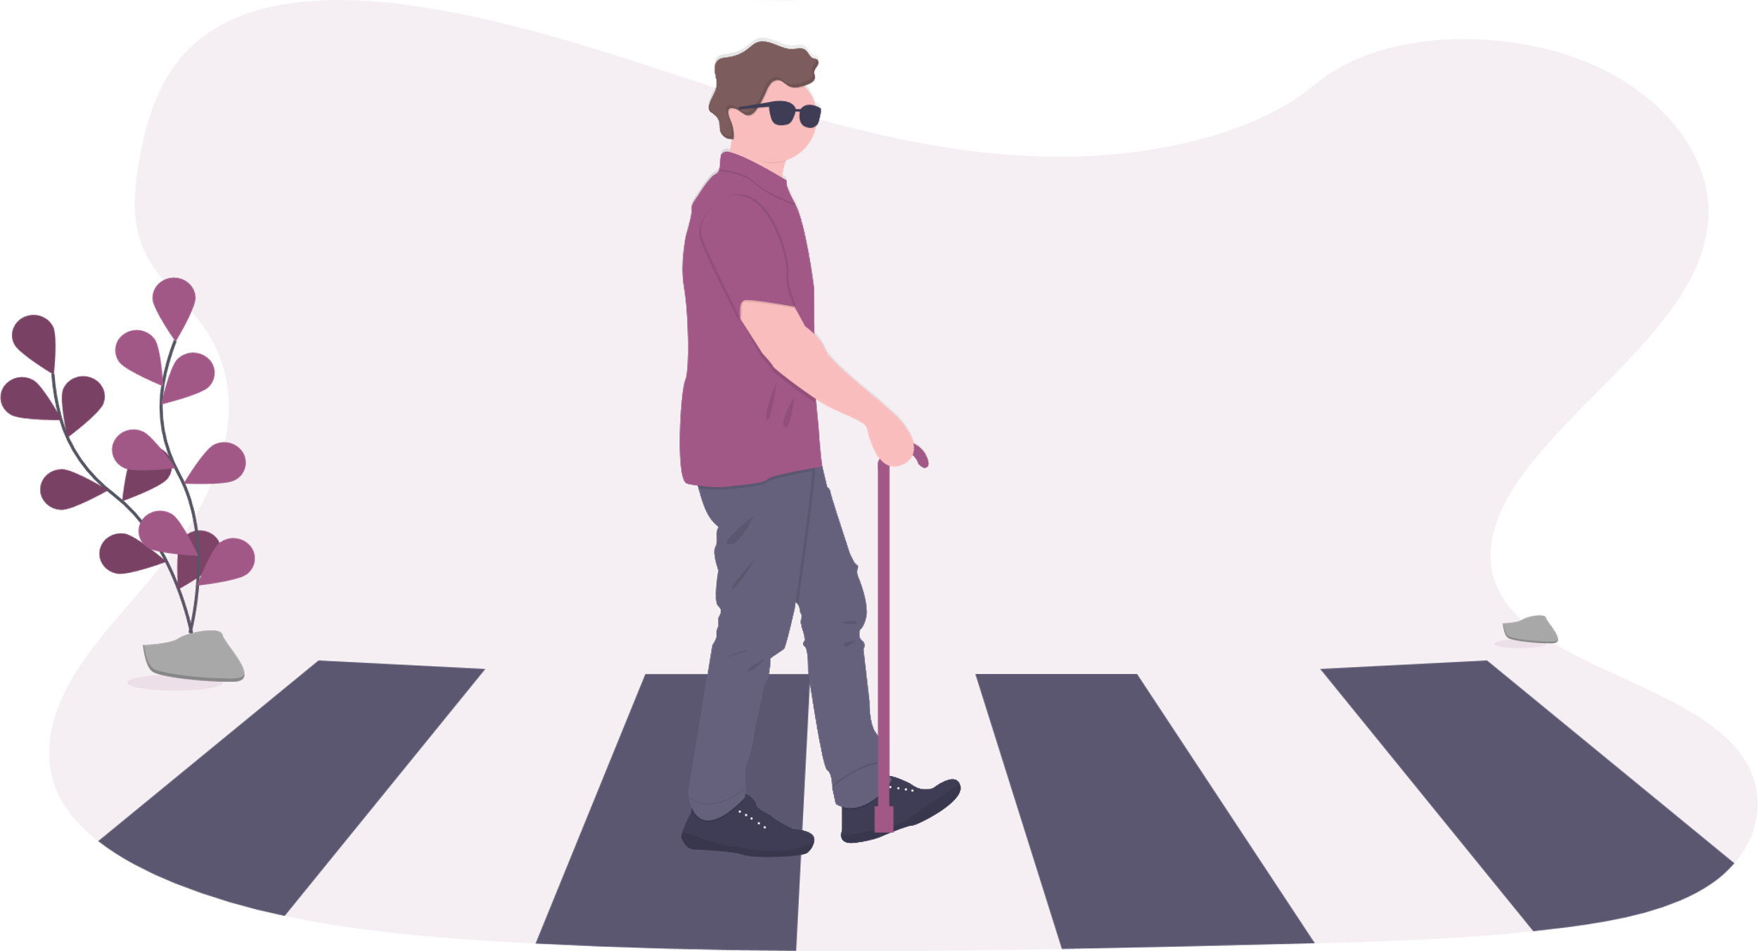
Visual impairment
Visual impairment is a term used to describe any kind of vision loss, whether it's someone who cannot see at all or someone who has partial vision loss.
Some people are completely blind, but many others have what's called legal blindness.
The world population is estimated to be around 7.9 billion, where around 304.1 million people suffer from some kind of visual impairment.

Slide 5

Visual impairment worldwide
16.15 %
Having some sort of visual impairment (304.1M)

Slide 6
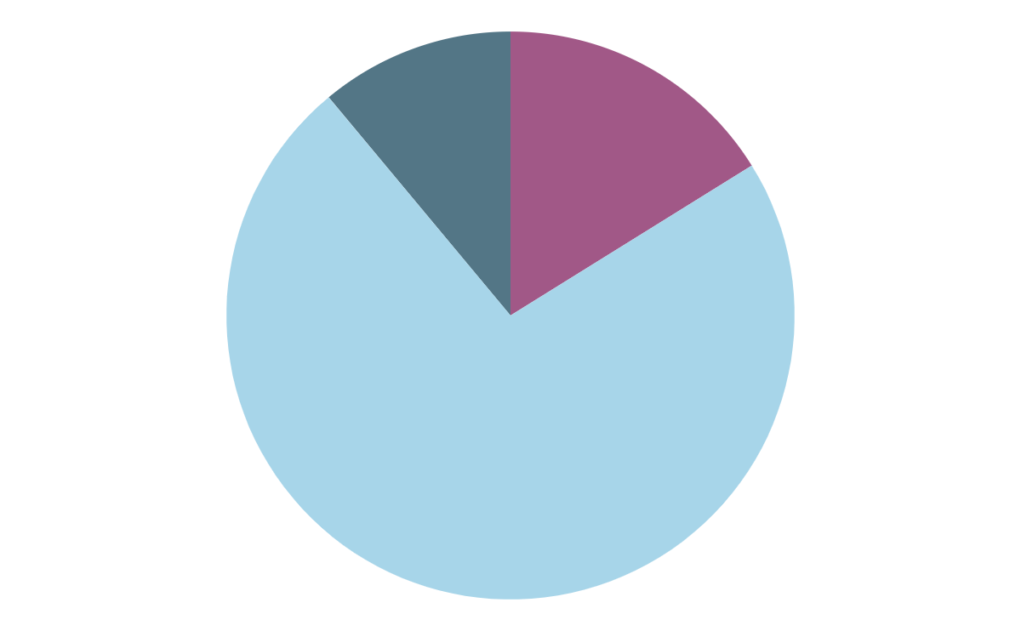
Vision impairment classification
11.05 %
16.15 %
72.8 %
Totally blind (49.1M)
Severe vision impairment (33.6M)
Moderate vision impairment (221.4M)

Slide 7

Difficulties
Having any kind of visual impairment can be difficult to live with, especially being blind.
Blind people encounter many challenges on daily bases, from getting up to going to sleep.
The bigger issue for them also is mobility, since they have no vision, it become hard to avoid obstacles, and navigate anywhere.
Furthermore, items loosing is a recurring problem among blind people, where they often can’t locate their phone, and the same thing applies to their white canes.

Slide 8
Goals
Our goal in this project, was to make a portable and an easy-to-use device, that helps people with visual impairment navigate anywhere, allowing them to search, find & discover places near him or far away from them.
Also the said device should alert the user of obstacles and help him to avoid them.
Further more, because the person cannot locate himself in foreign areas, we should be able to inform him of his current location with ease, and allow him to ask for help if he needs to.

Slide 9
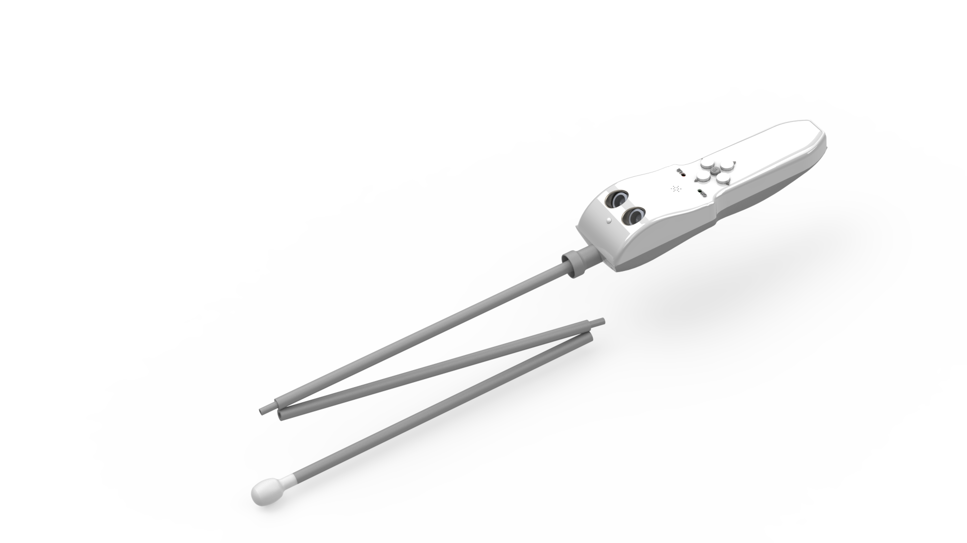
Summary
GuideMe is a smart cane, made for the visually impaired individuals, to facilitate their daily life and help them navigate the outside world.
While making GuideMe, we had usability, simplicity, functionality and visual appeal in mind, and as can be seen in the final product, we were able to successfully hit all of these goals.
GuideMe cane can be paired with your mobile phone to make use of more smart features.

Slide 10
02
DESIGN
Ergonomics, usability & Visual appeal

Slide 11
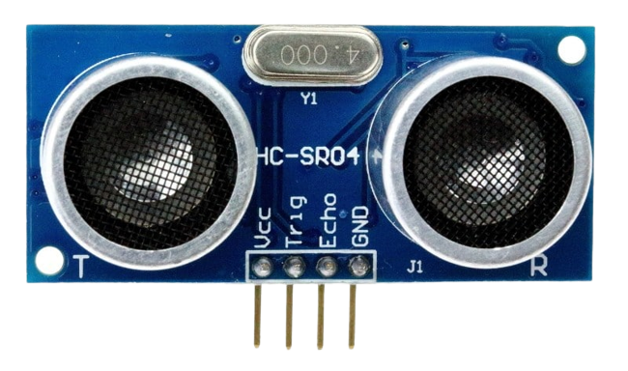
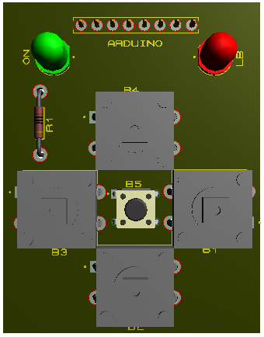
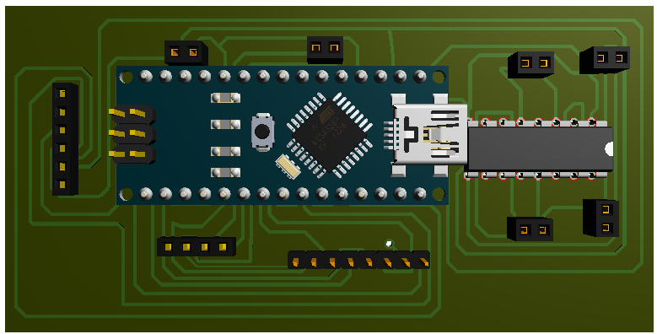
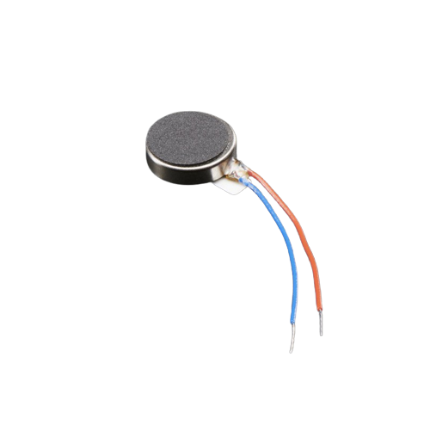
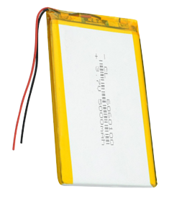
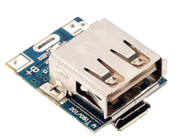
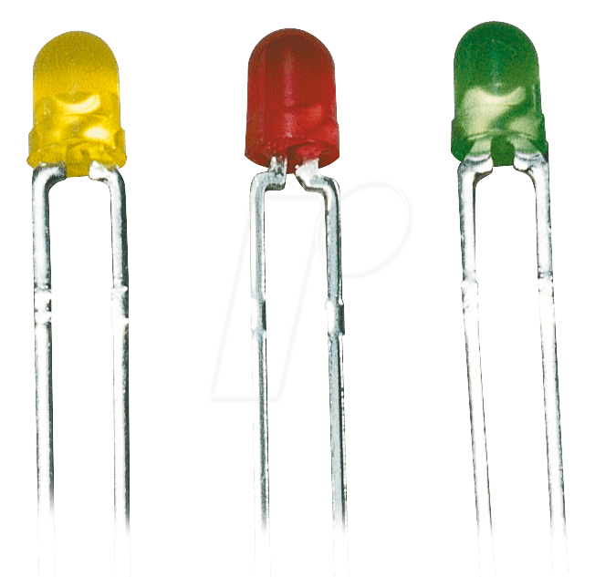
Before we could start the design, we had to think about what components should go inside, and we had many.
To implement the features we will be explaining later, we had several components to use.
Proximity sensor: HC-SR04
Arduino PCB
Buttons PCB
Battery & its power circuit
Motor vibrators and LEDs

Slide 12
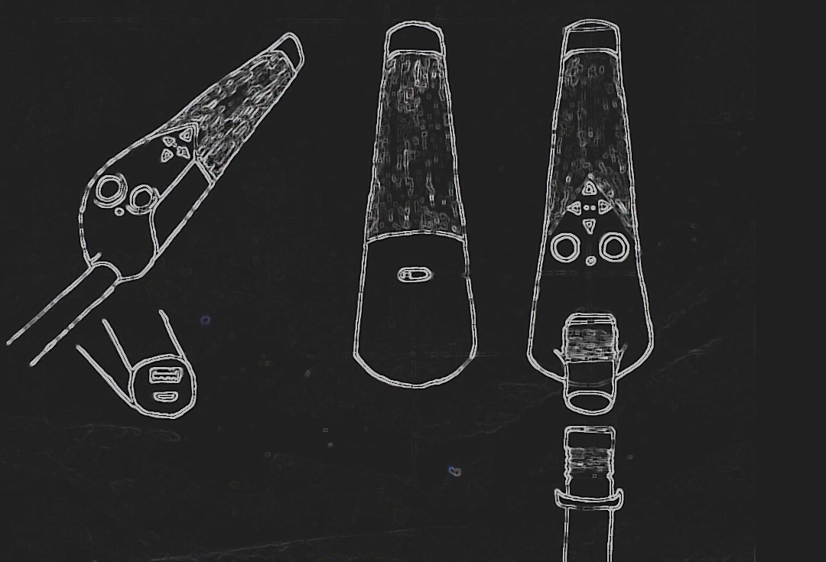
But before taking real measurements, we started with a rough 2D sketch:
Proximity sensor
Control buttons
Power switch
Power I/O

Slide 13
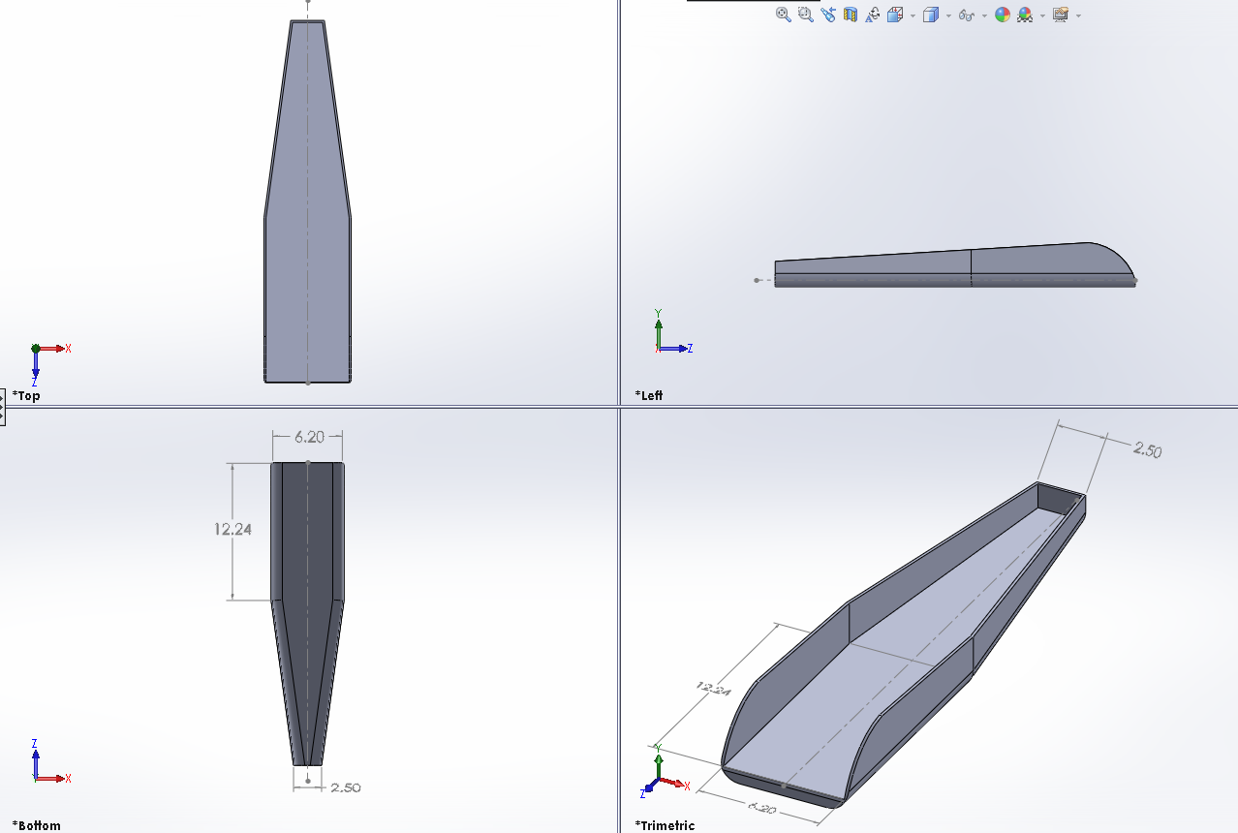
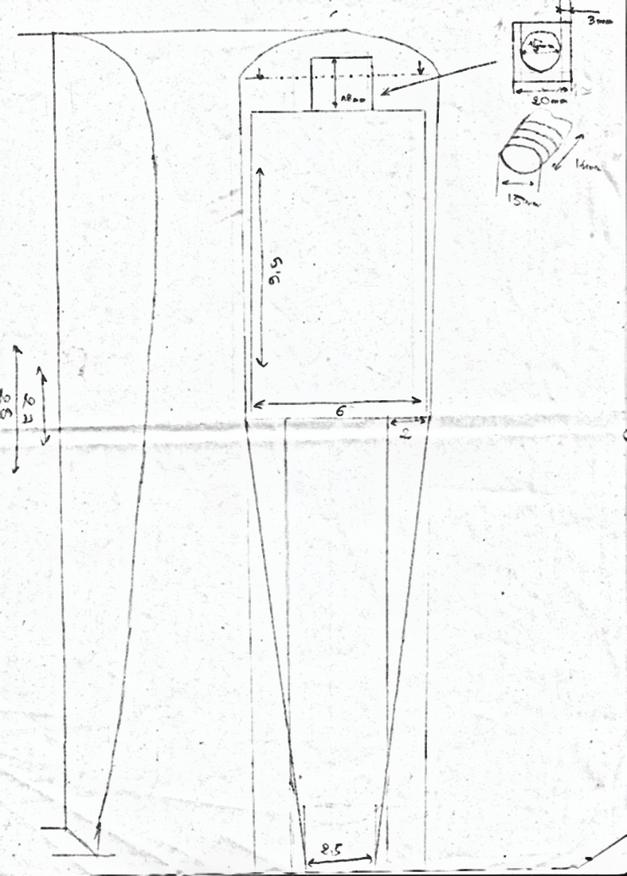
We then moved into making it with real measurements:

Slide 14
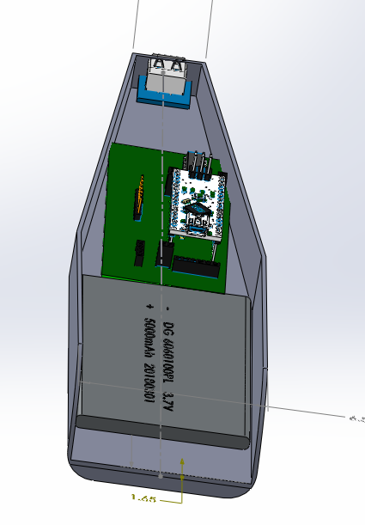
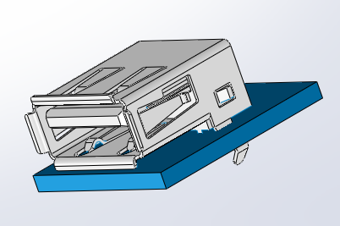
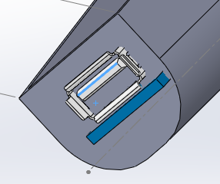

Slide 15
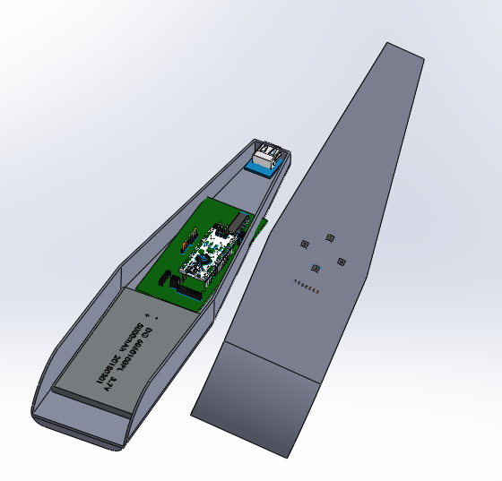
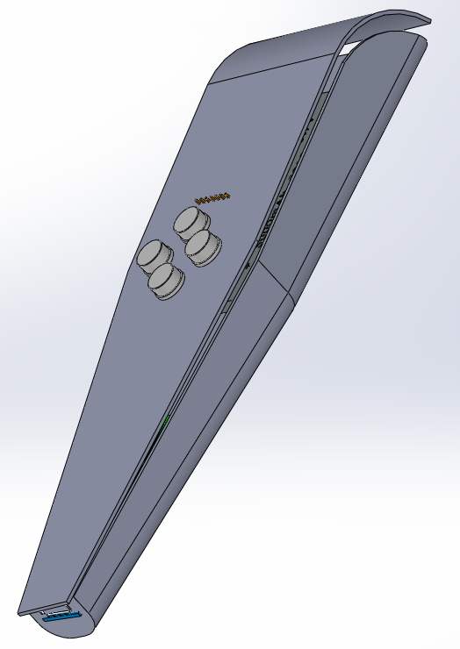

Slide 16
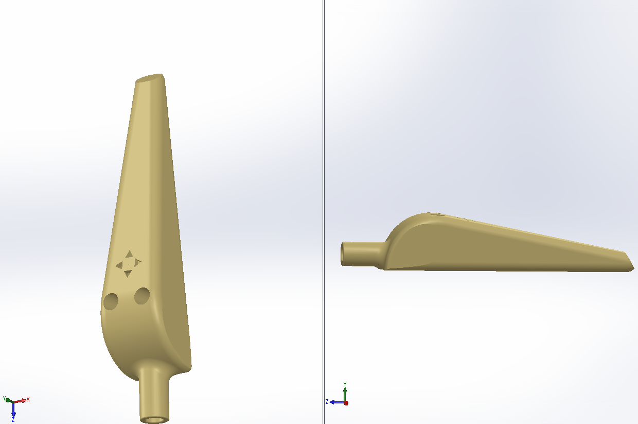
And after more work, this was the finale product

Slide 17
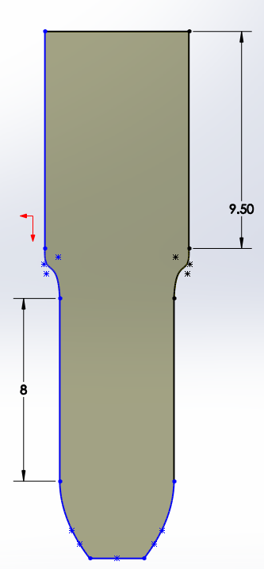
As you can notice, the design wasn’t appealing or comfortable to use, it was also kind of chubby and big in the hand to hold, which will make it uncomfortable and restraining for long usage time.
So we just decided to delete everything and restart from scratch.
We create a new plane, and we take it from here

Slide 18
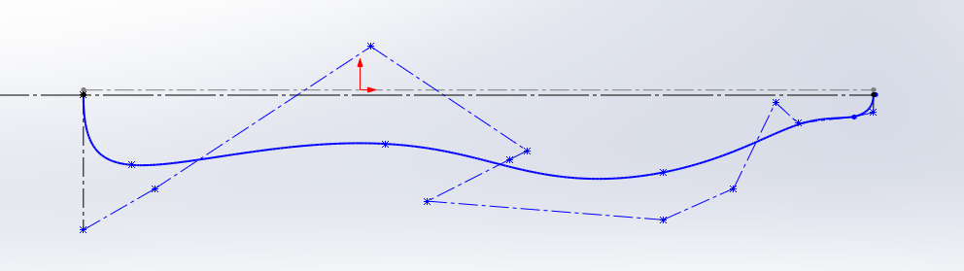
Then we add curves

Slide 19
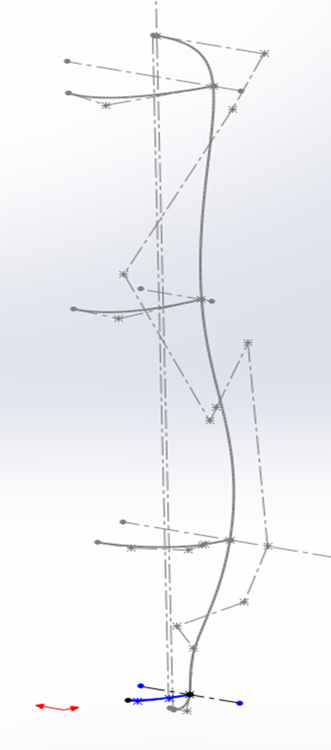
And more curves

Slide 20
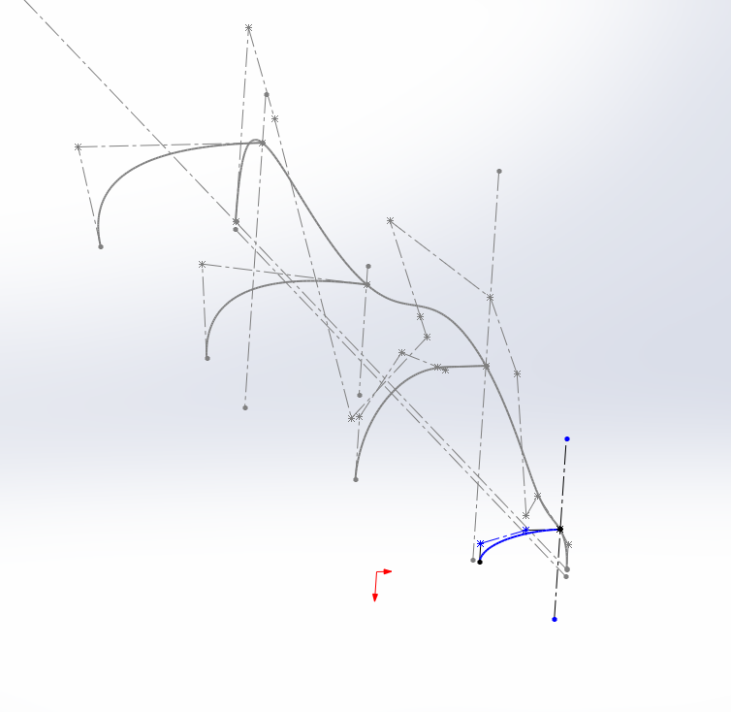
Then more and more curves…

Slide 21
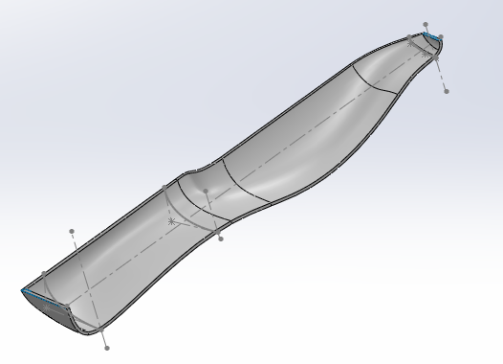
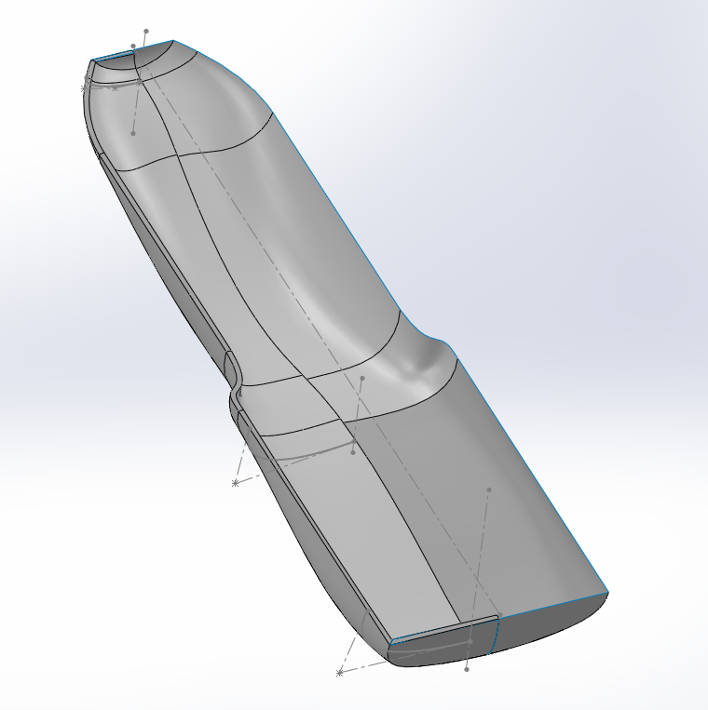
Until we end up with this

Slide 22
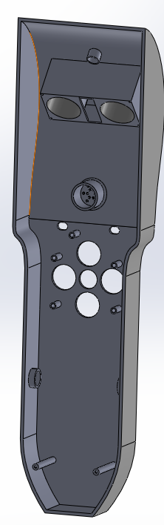
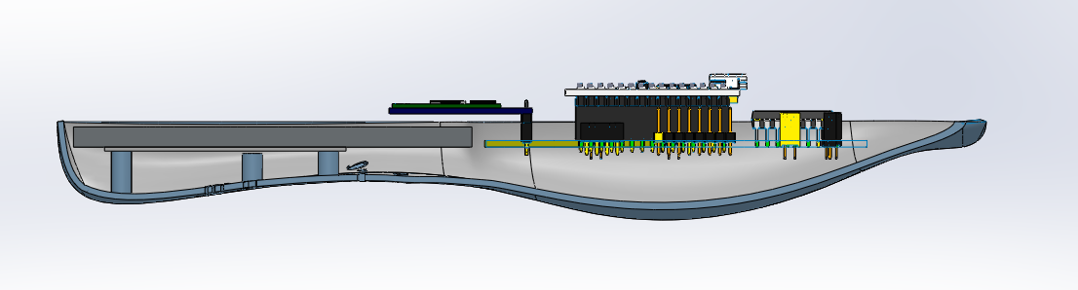
We can still fit everything into the case

Slide 23
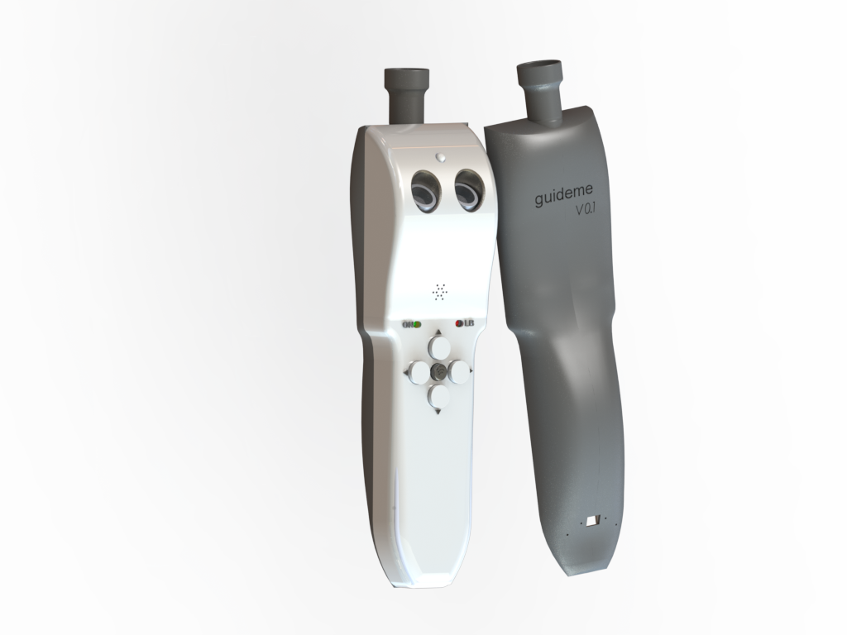
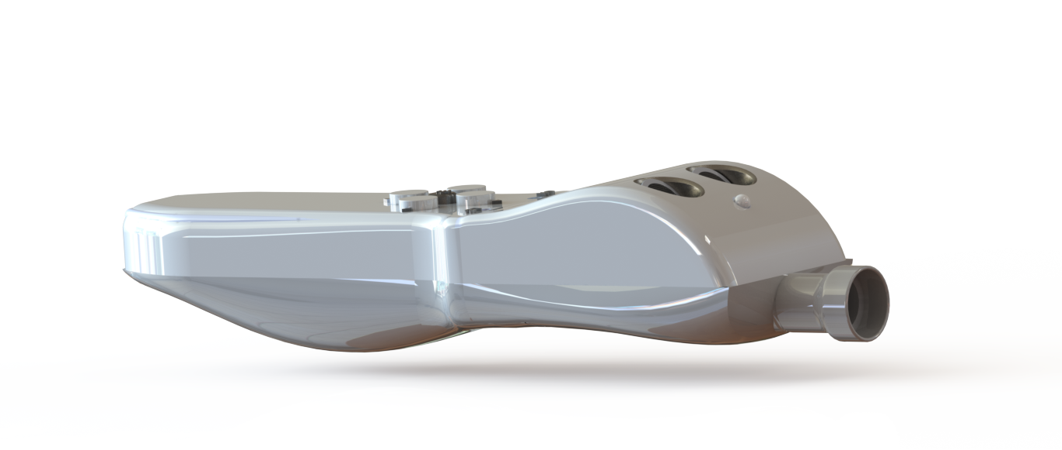
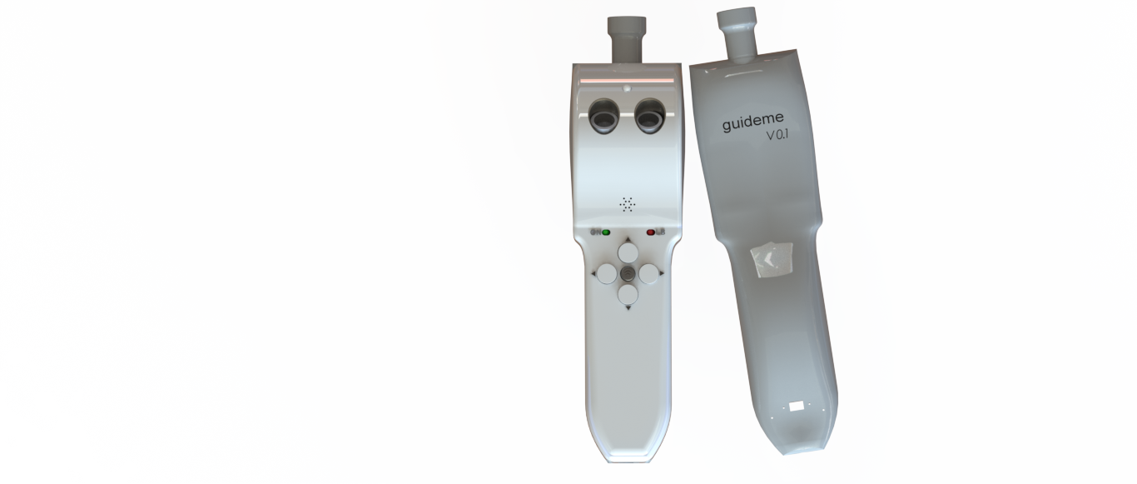
Final product

Slide 24
03
Features & functionalities
Architecture, features & usage

Slide 25
1. Detect obstacles
GuideMe vibrates to inform you of low-hanging obstacles that the bottom of a cane may typically miss, such as a sign or tree branch.
The vibration intensity changes depending on the proximity of the said obstacle.

Slide 26
Using the HC-SR04 proximity sensor, we can measure distance between the cane and obstacle in front of it.
This sensor can measure from 2cm up to 400cm (4m) with a precision of ±3cm.
The distance read from the sensor is fed to the Arduino to calculate the PWM output that controls the vibration motor intensity.
The PWM output is linear to the obstacle proximity, the closer the obstacle is, the more intense is the vibration.

Slide 27
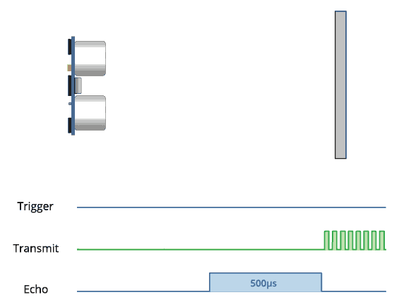
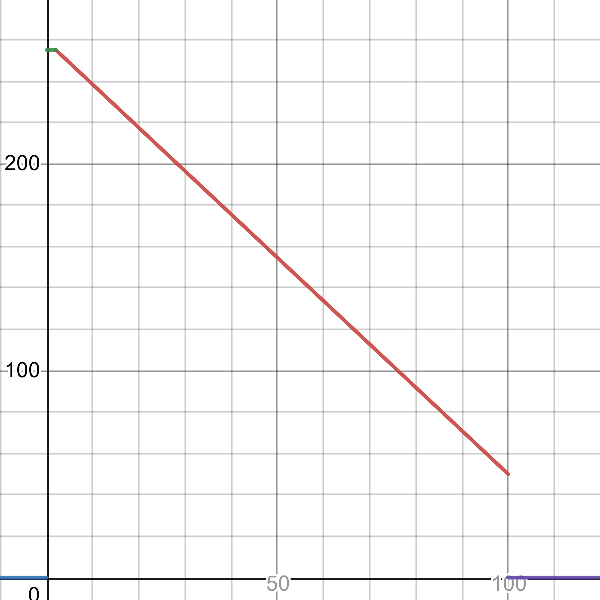
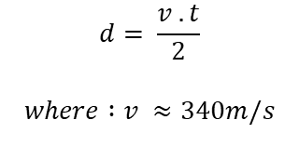
$$d= \frac{v . t}{2}$$
$$where :v ≈340m/s$$
PWM output in relation of the proximity of obstacles

Slide 28
2. Search & Discover
Find your current location and search for the places you know, or discover new ones around you. All controlled from the app or cane.

Slide 29
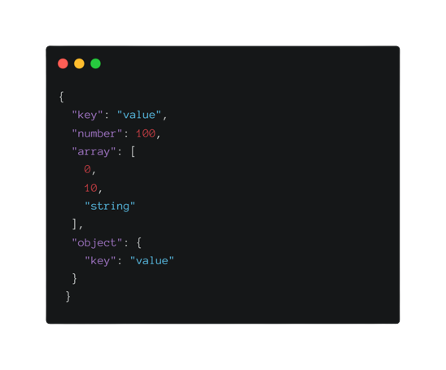
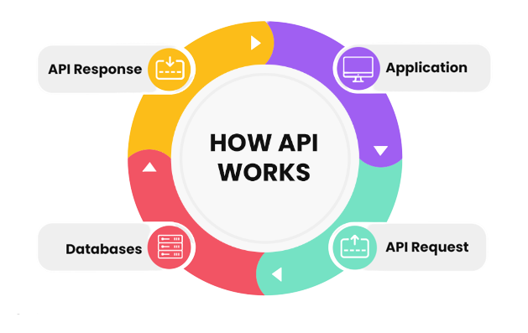
Using the Google APIs, we can request for places nearby providing our current location.
The API returns a JSON response (JavaScript Object Notation) containing information about proximity places.

Slide 30
Discover

Slide 31
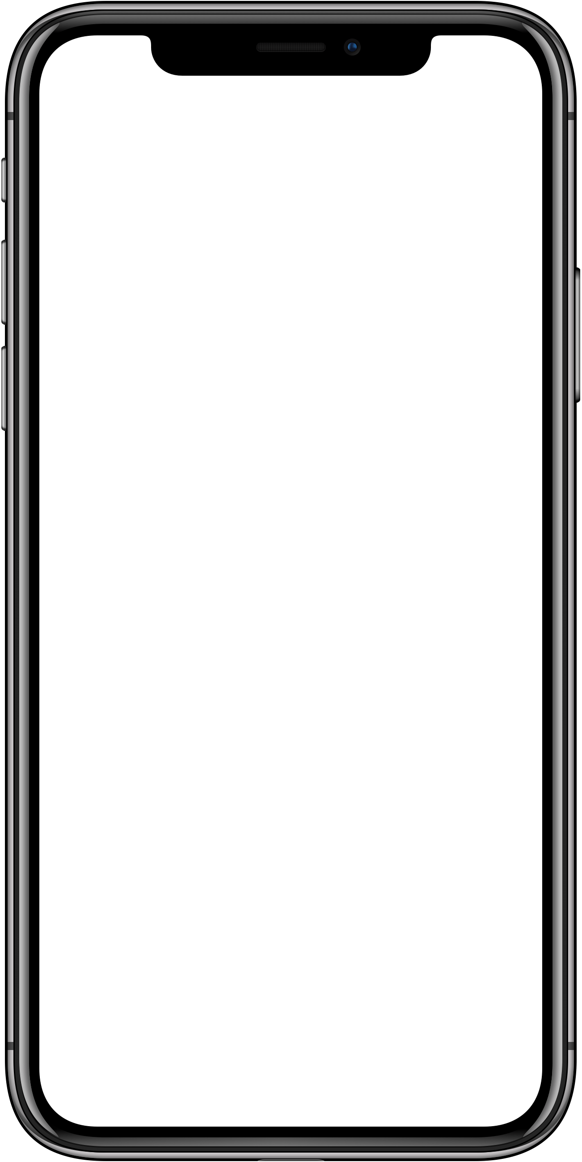
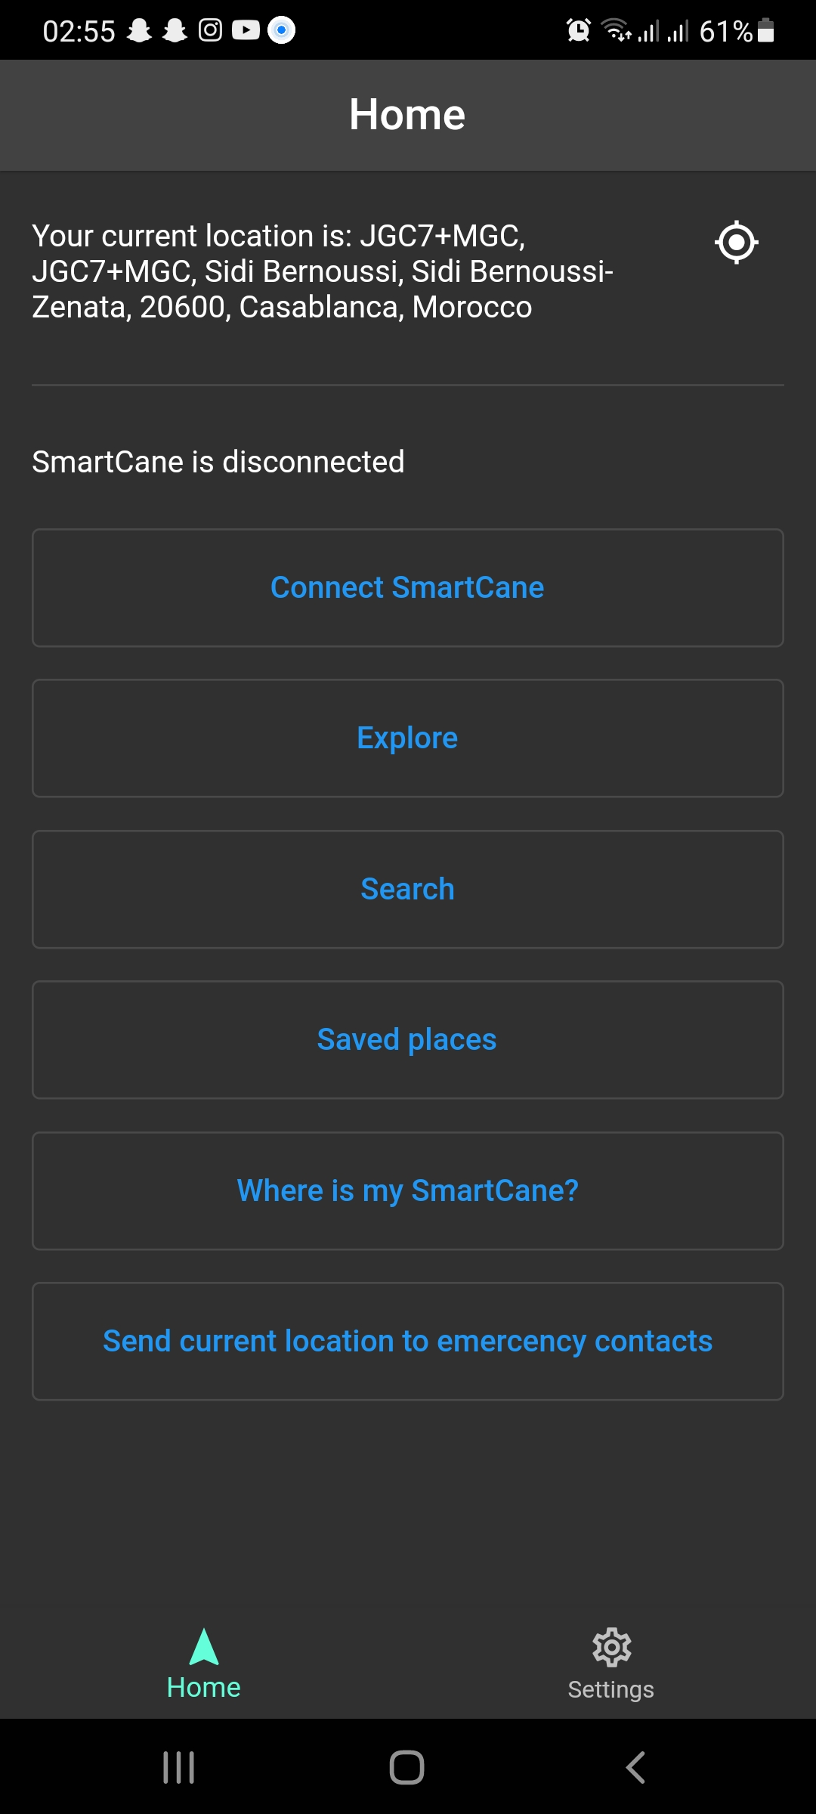
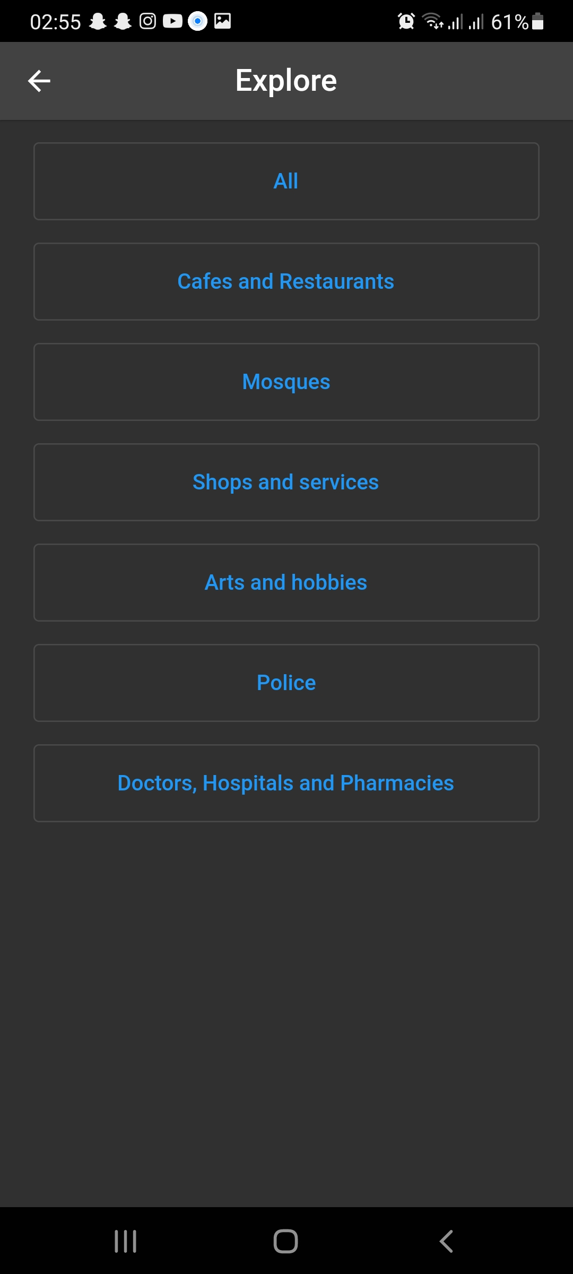
Current location
Update current location
Places types

Slide 32
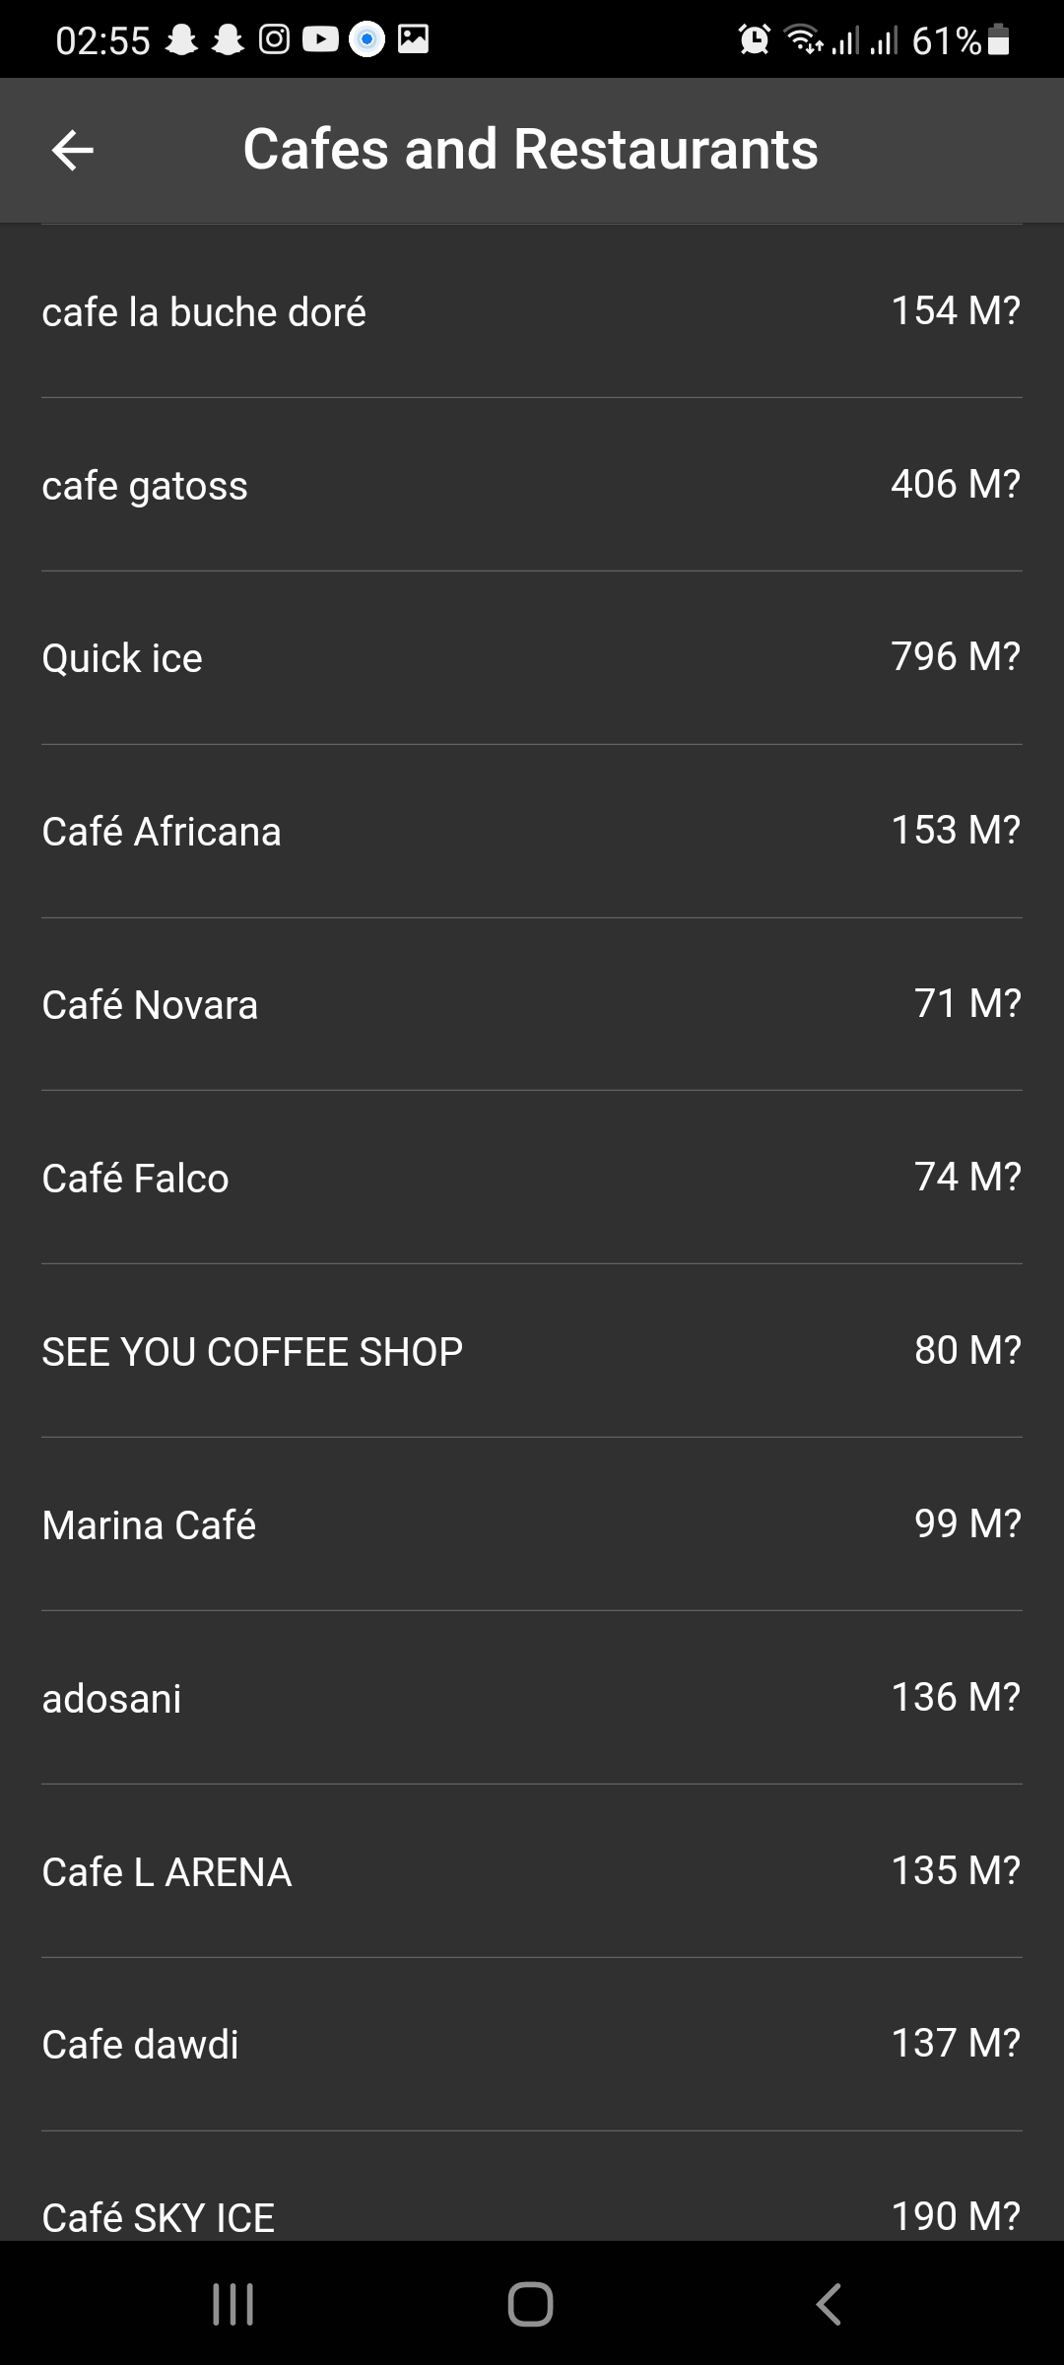
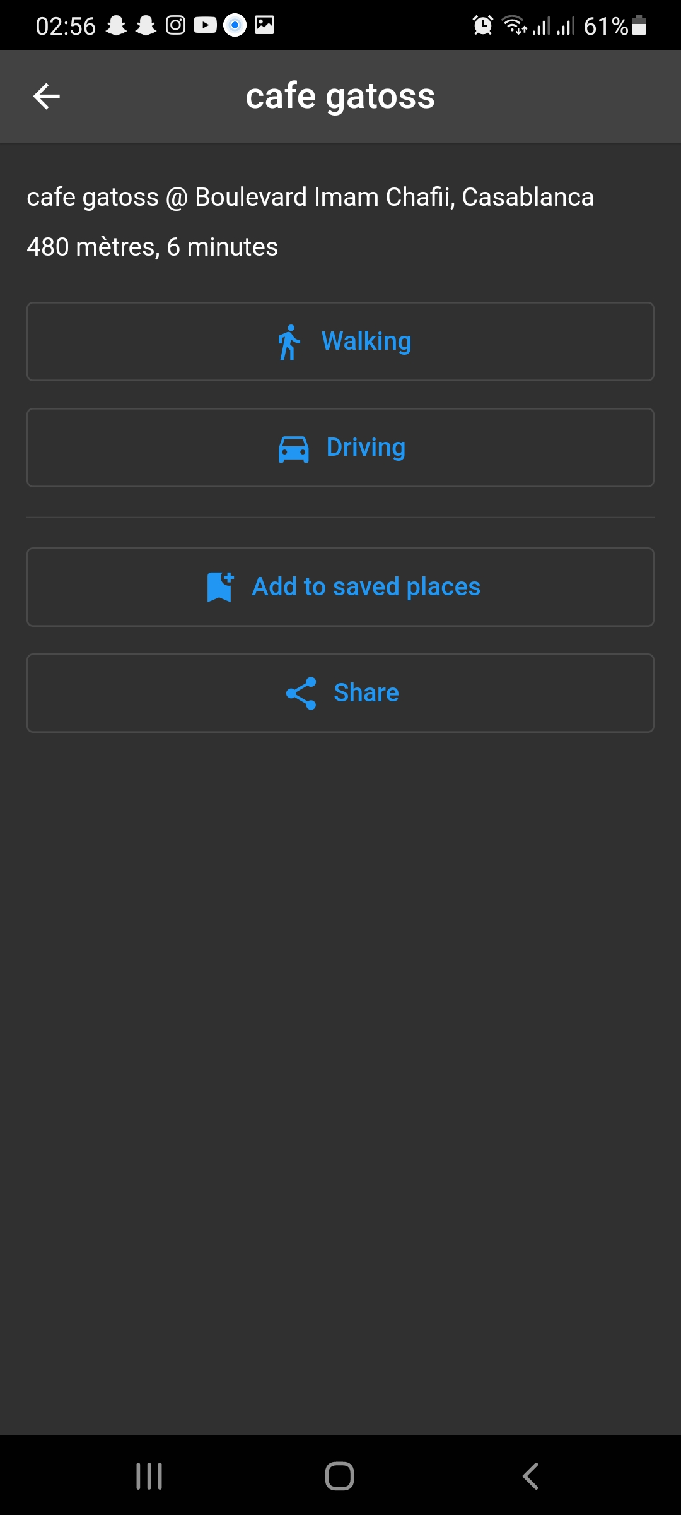
Place name
Selected type
Estimated distance
Vicinity
Estimated walking duration
Exact distance
Place name

Slide 33
Search

Slide 34
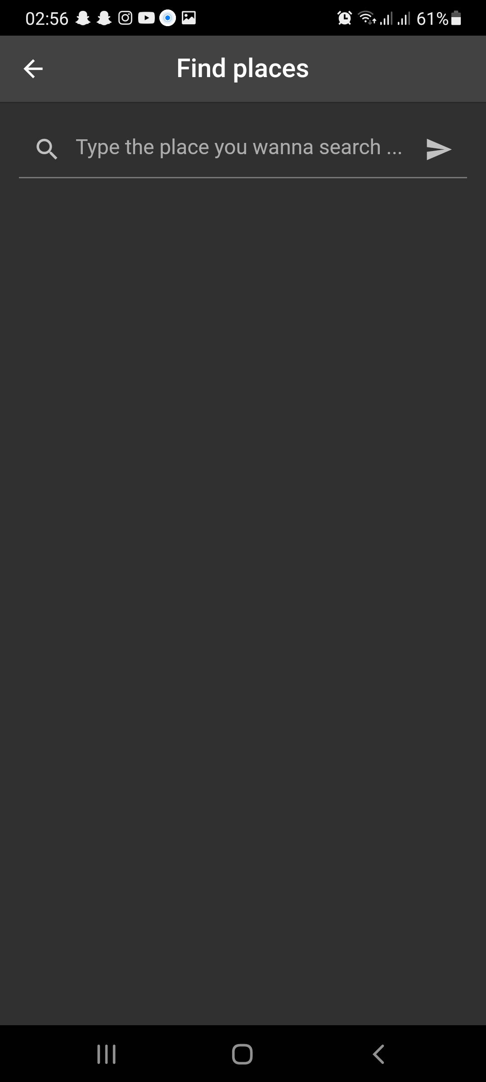
Current location
Update current location
Search button
Text input

Slide 35
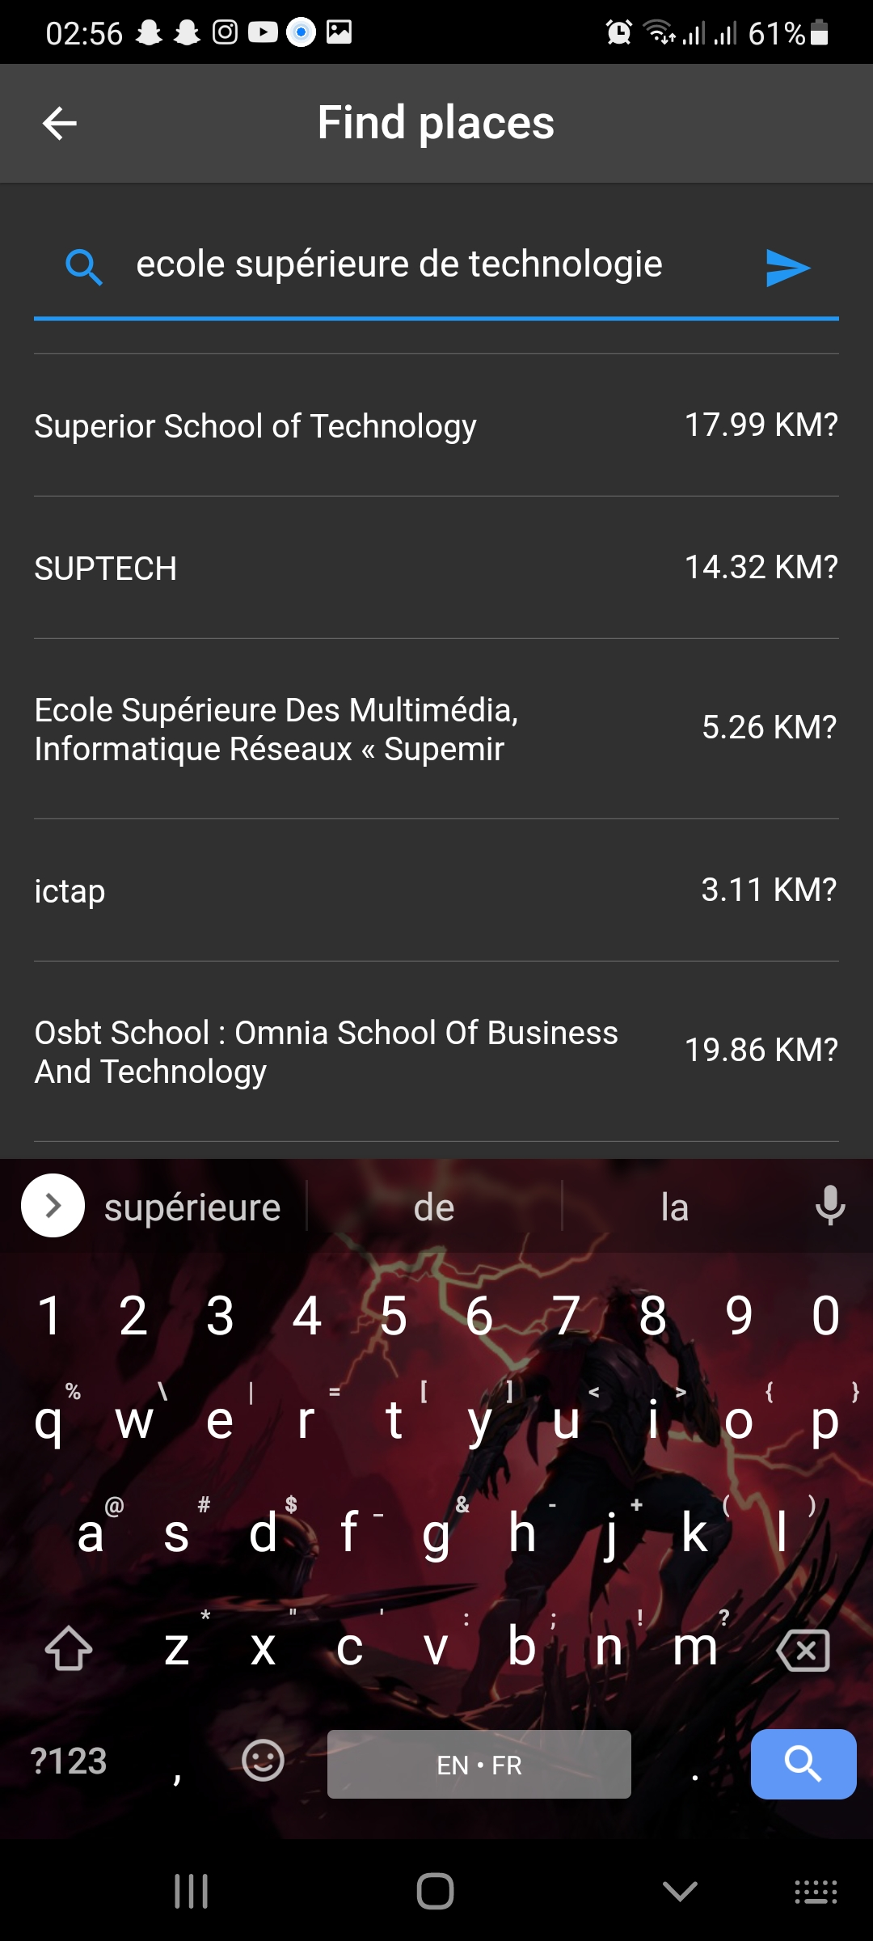
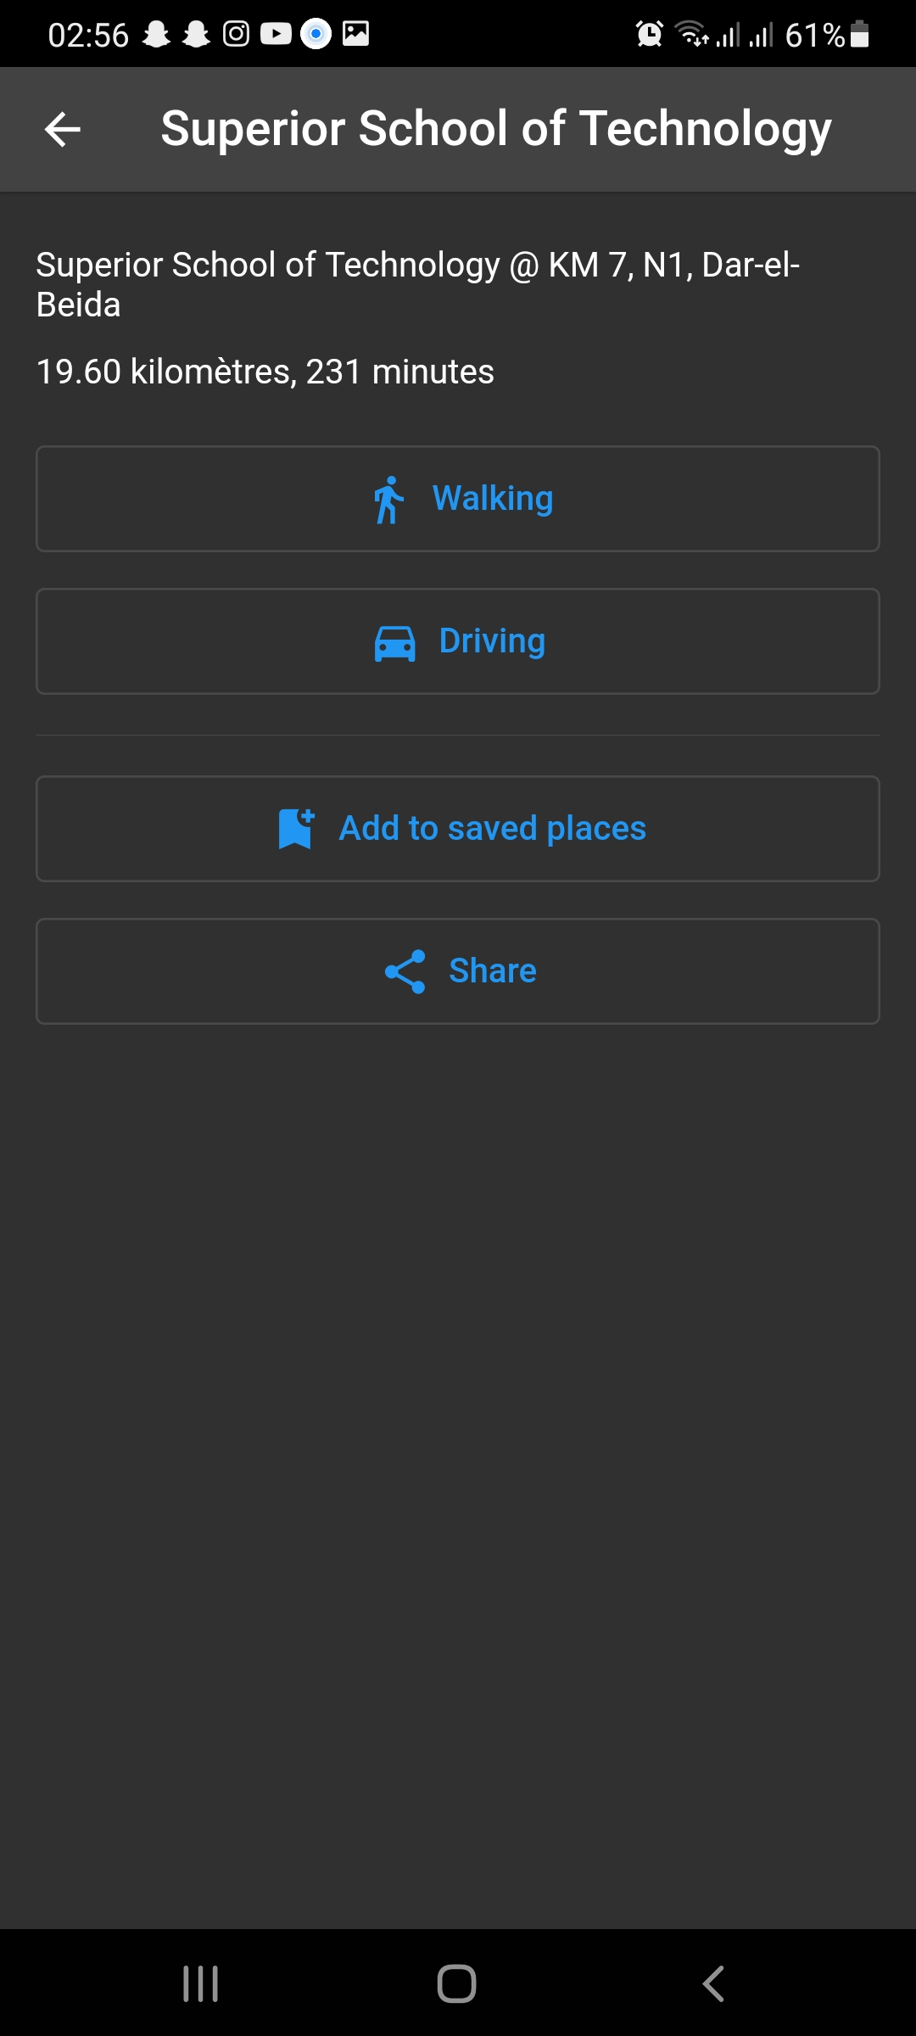
Place name
Exact distance
Vicinity
Estimated walking duration
Place name
Estimated distance

Slide 36
3. Navigate
Use Google Maps for a step by step navigation guide to your destination.
Voice feedback can come from your phone’s speaker or via a Bluetooth headset.

Slide 37
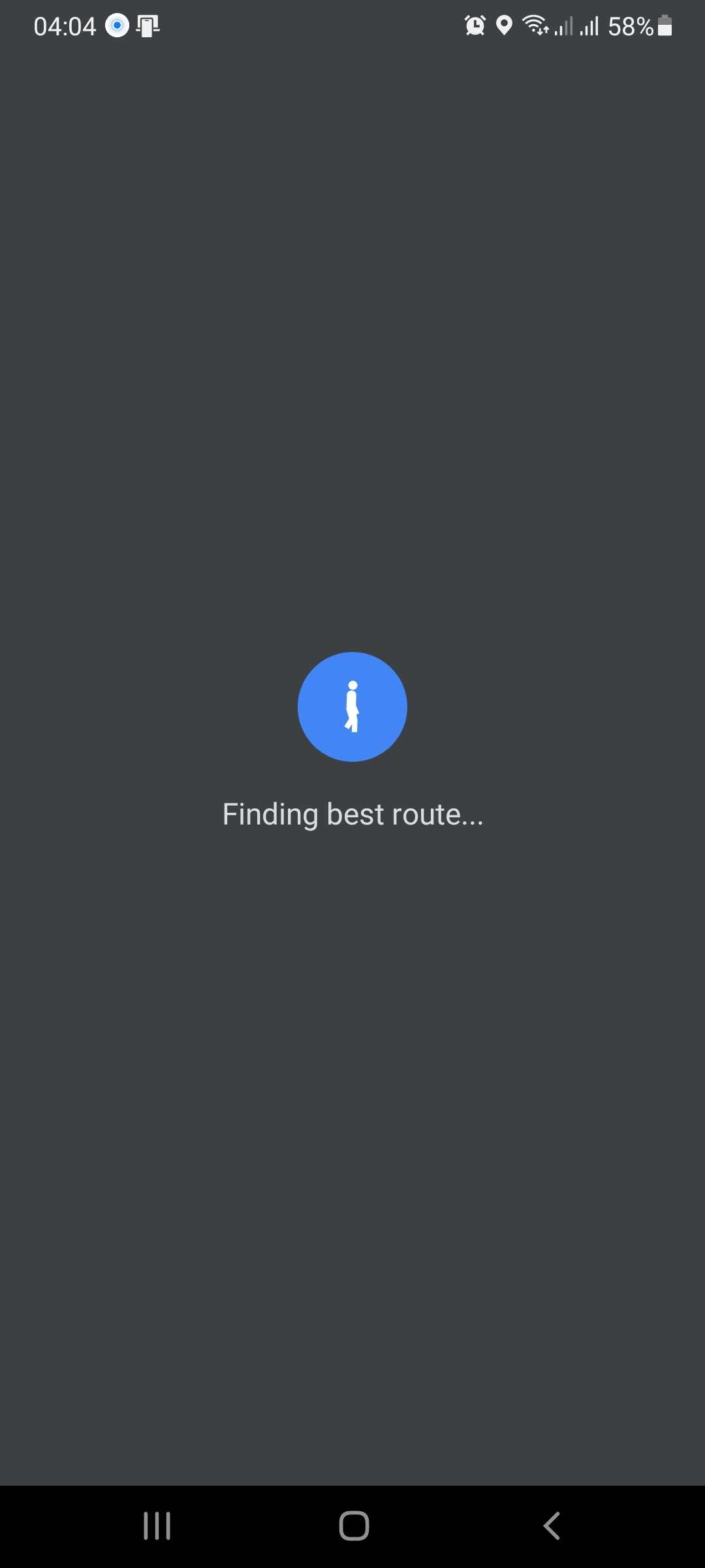
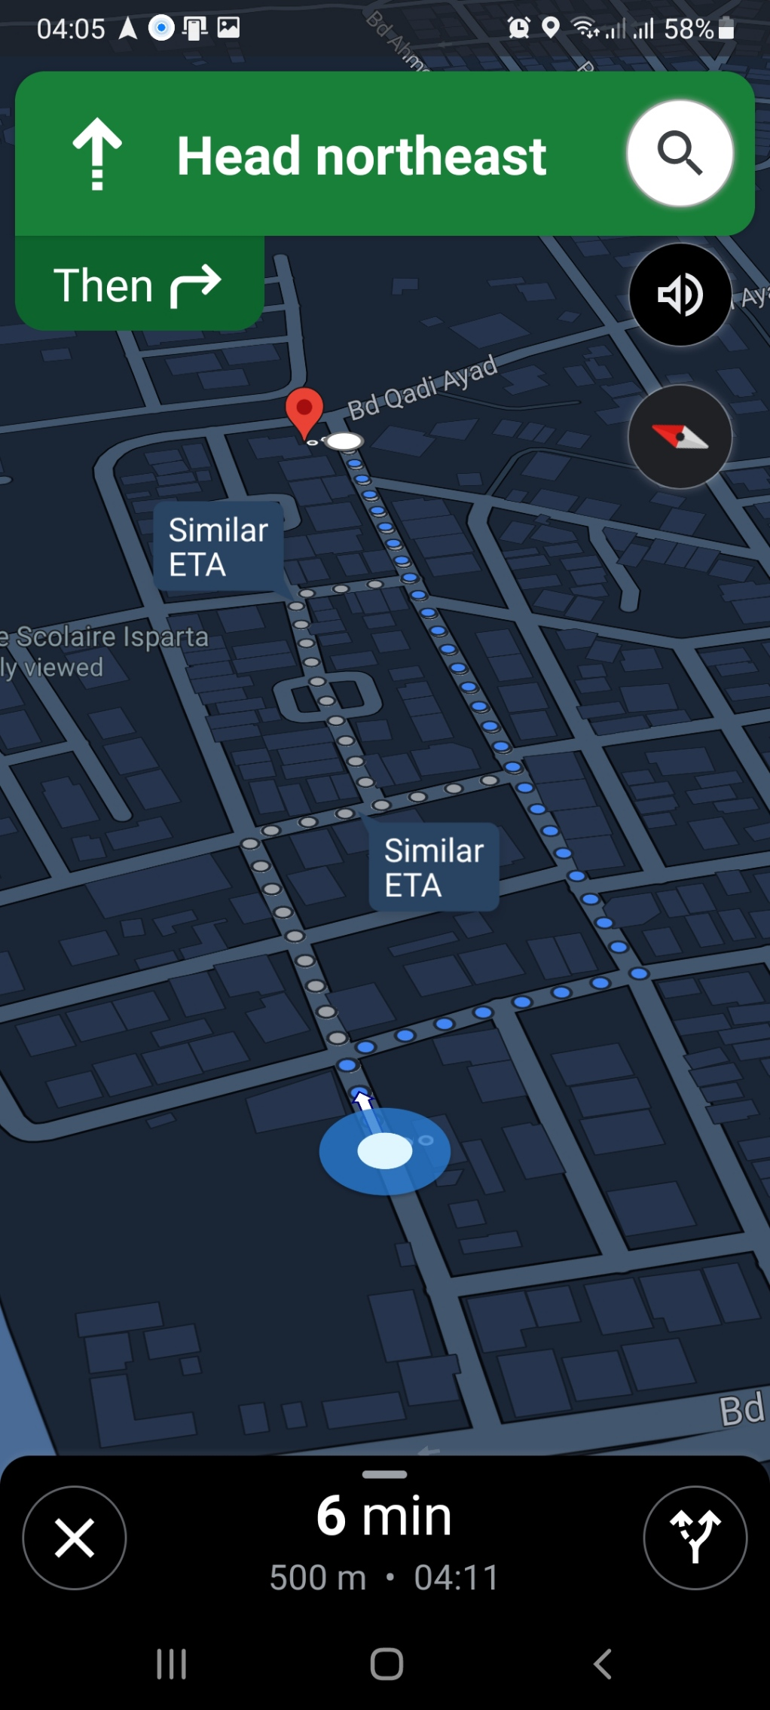
Available navigation guides

Slide 38

4. Save & share your favorite places
Save the places you like, and share them with whoever you want.
The shared link opens in GuideMe mobile app if installed, otherwise it open the website

Slide 39
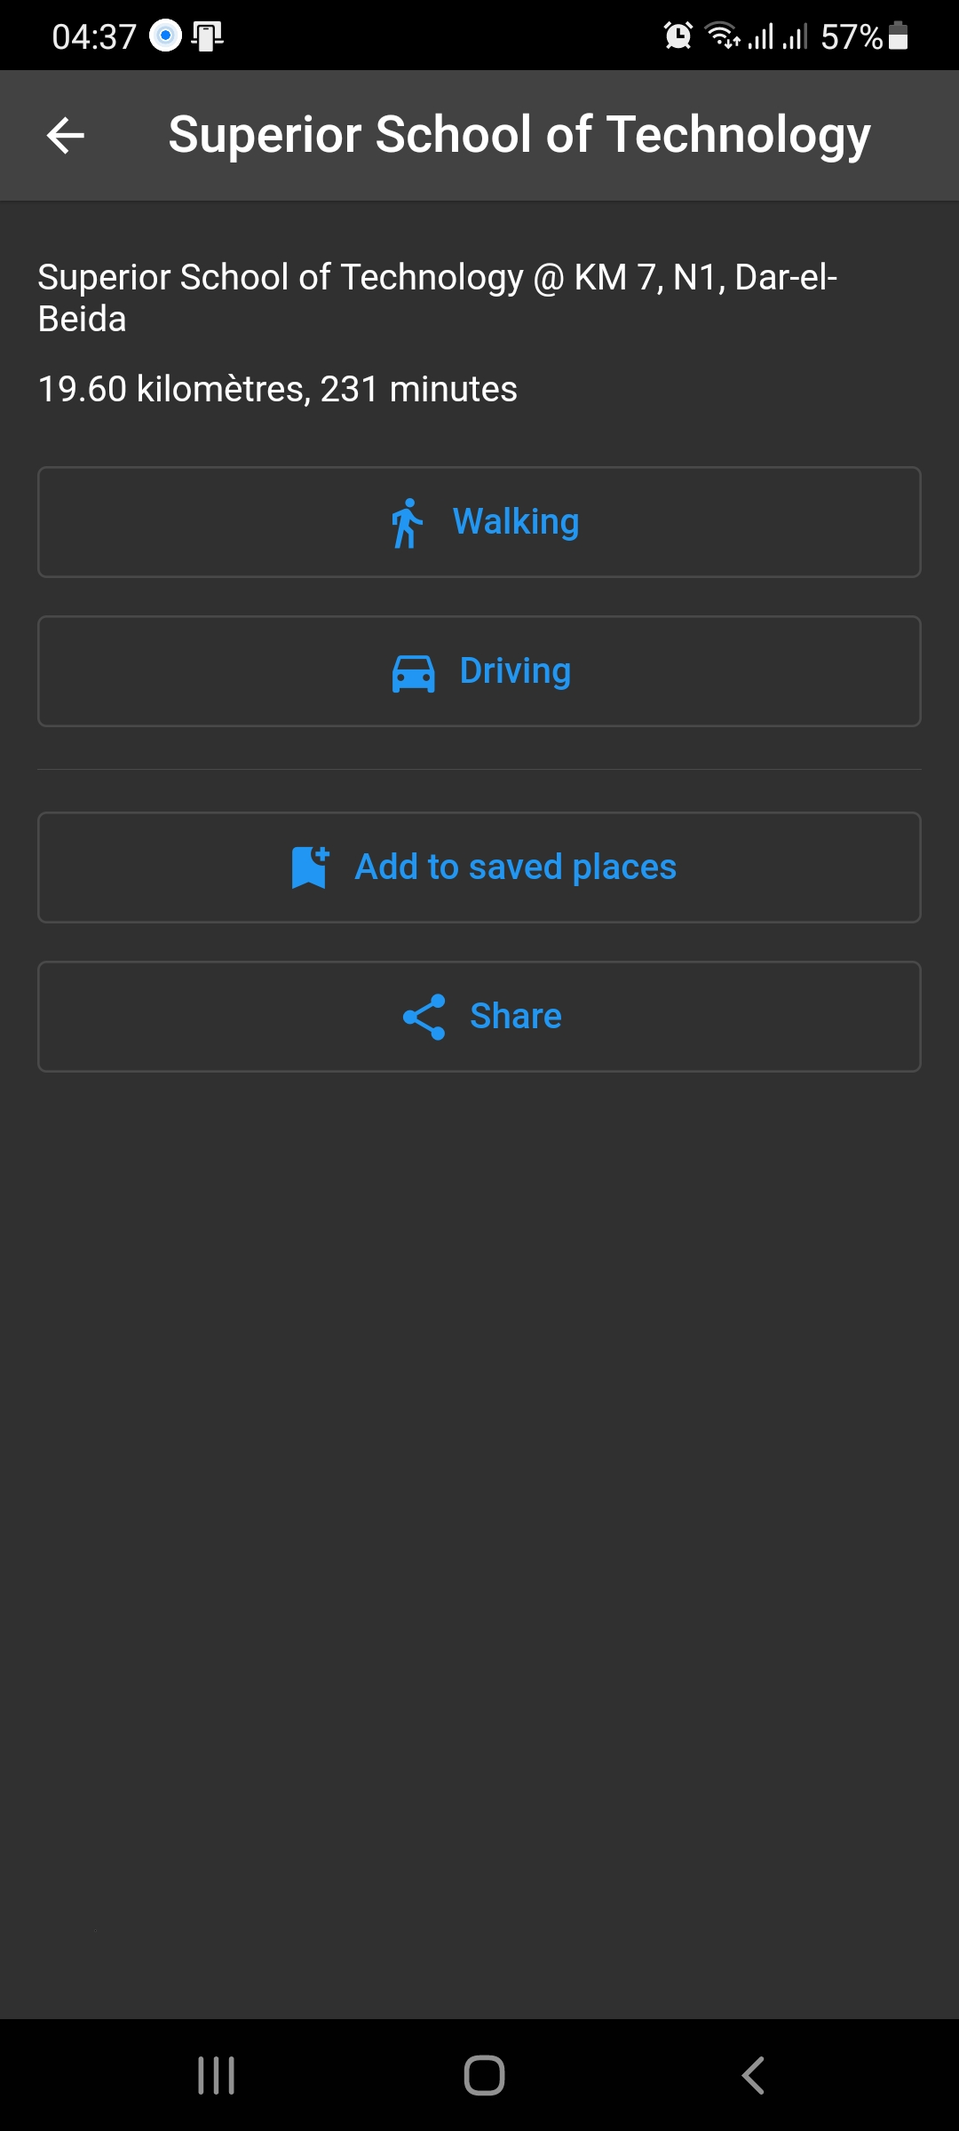
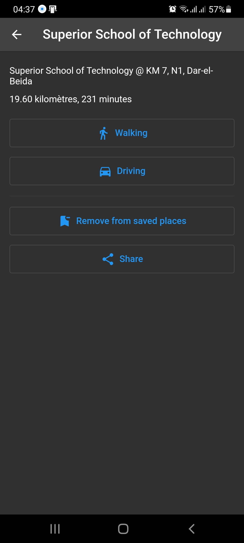
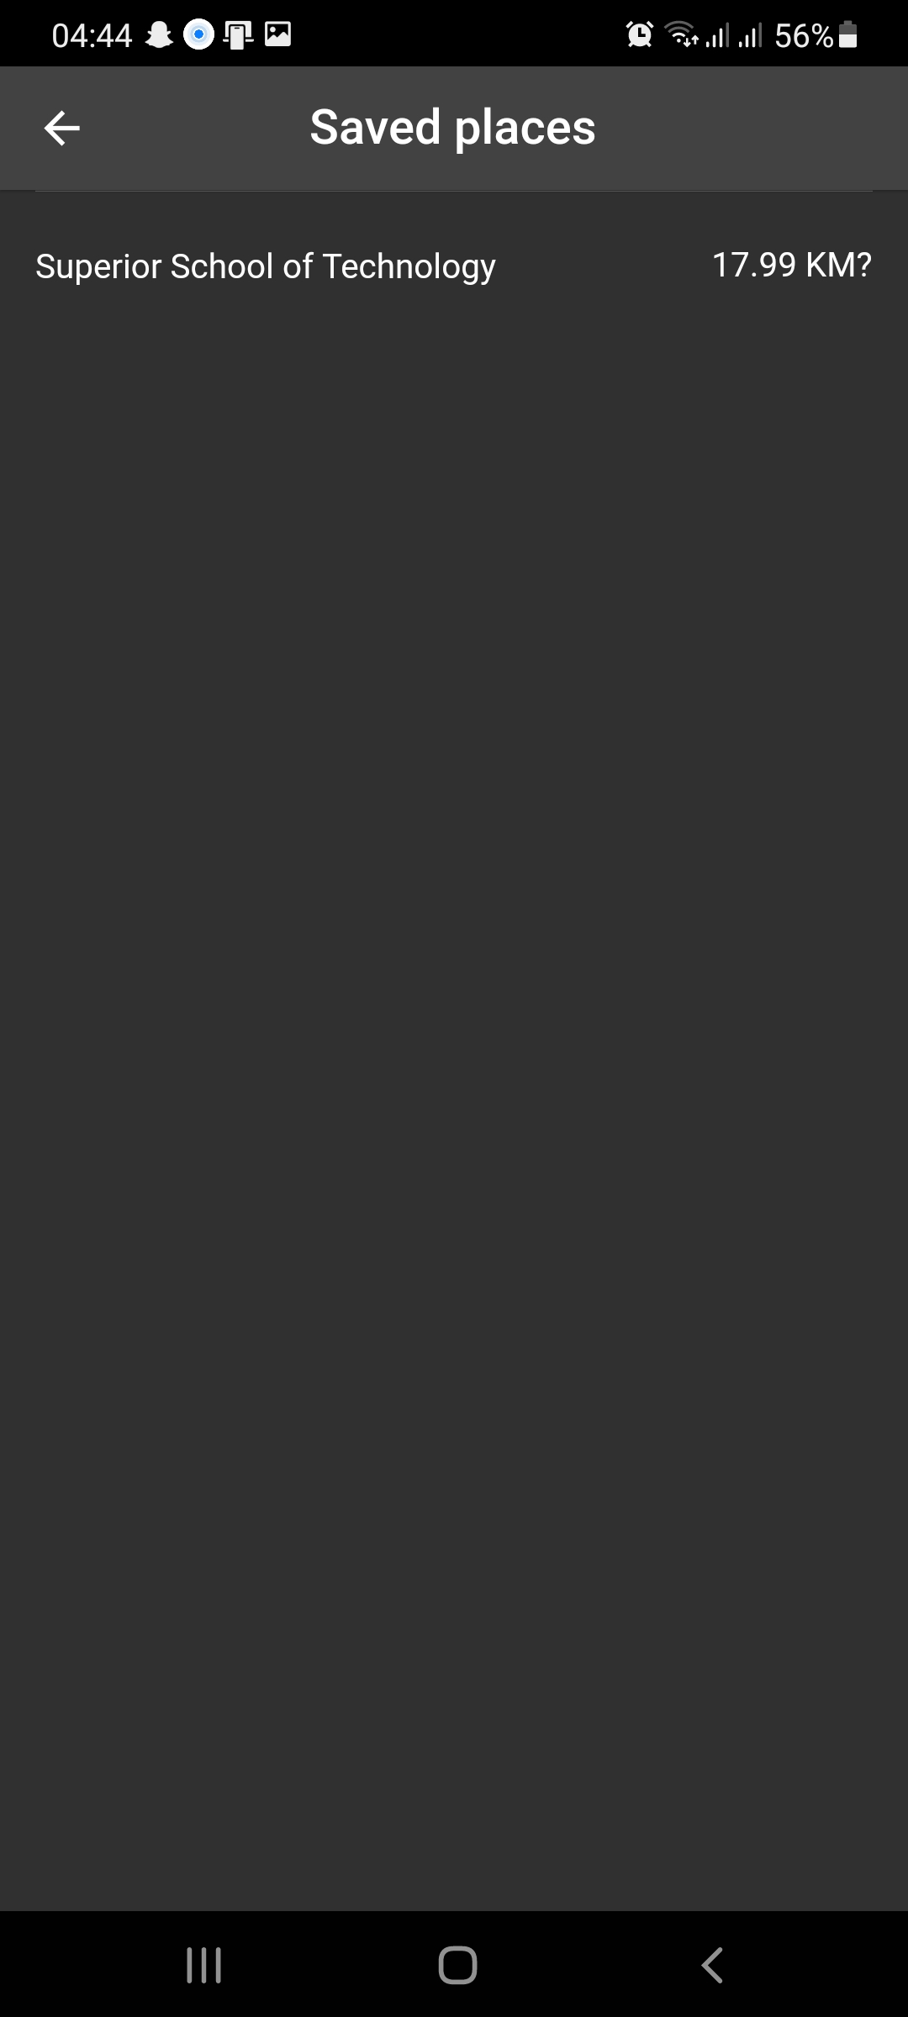
Add/Remove places from favorites list

Slide 40


The message contains a link to access the shared place information

Slide 41


In case the link was opened on a phone where the GuideMe application is installed, the information for the shared placed will be shown on the app.
On the other hand, if the link was accessed on a phone that does not have the GuideMe app installed, or opened on a computer, the information will be shown by our website.

Slide 42
4. Find your phone using your cane & vice-versa
In case of cane loss, you can use your phone to play a ringtone on the cane, and vise-versa.

Slide 43

5. Share you current location easily
You can send a SMS message containing your current location to a predefined list of contacts .
You can customize the list and the message from the settings screen

Slide 44



SMS received by Iliass
SOS message can be sent from the mobile application, or from the button on the cane

Slide 45
Thank you for your attention
If you have any question, don’t be shy to ask!

